Slide 1

Monte Carlo Simulation framework
The mass balance framework leads us to expect that if all sources of arsenic are accounted for, $ℰ≅𝒟$, where $ℰ$ is a measure of arsenic excretion and $𝒟$ is a measure of recent arsenic intake
Therefore, regressing a measure of $ℰ$ on a measure$\hat{𝒟}$may be used to infer whether sources of arsenic are adequately accounted for in $\hat{𝒟}$

Slide 2
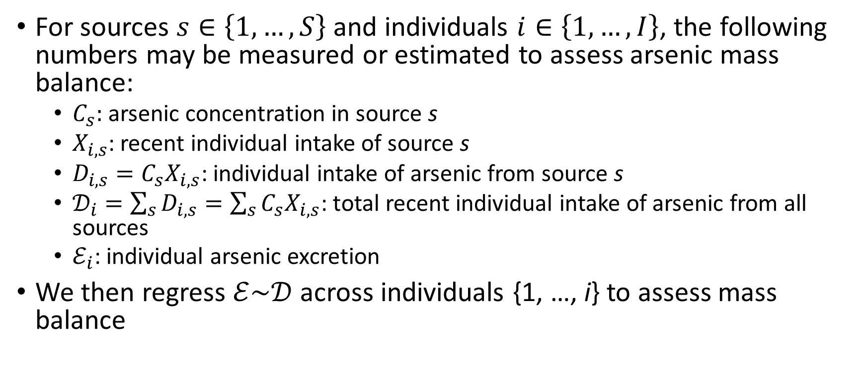
Monte Carlo Simulation framework
For sources $s∈\left\{1,…,S\right\}$ and individuals $i∈\left\{1,…,I\right\}$, the following numbers may be measured or estimated to assess arsenic mass balance:
$C_{s}:$ arsenic concentration in source s
$X_{i,s}$: recent individual intake of source s
$D_{i,s}=C_{s}X_{i,s}$: individual intake of arsenic from source s
$𝒟_{i}=\sum_{s}{D_{i,s}=\sum_{s}{C_{s}X_{i,s}}}$: total recent individual intake of arsenic from all sources
$ℰ_{i}$: individual arsenic excretion
We then regress $ℰ\sim 𝒟$ across individuals {1, …, i} to assess mass balance

Slide 3
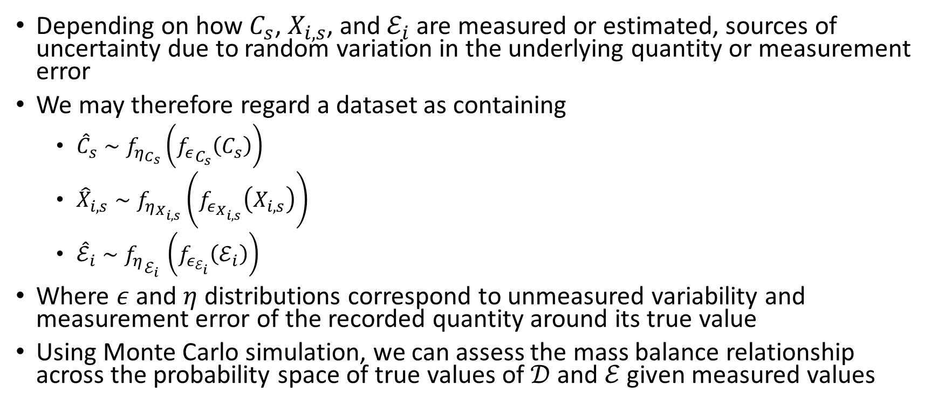
Monte Carlo Simulation framework
Depending on how $C_{s}$, $X_{i,s}$, and $ℰ_{i}$ are measured or estimated, sources of uncertainty due to random variation in the underlying quantity or measurement error
We may therefore regard a dataset as containing
${\hat{C}}_{s}∼f_{η_{C_{s}}}\left({f_{ε}}_{C_{s}}\left(C_{s}\right)\right)$
${\hat{X}}_{i,s}∼f_{η_{X_{i,s}}}\left(f_{ε_{X_{i,s}}}\left(X_{i,s}\right)\right)$
${\hat{ℰ}}_{i}∼{f_{η}}_{ℰ_{i} }\left(f_{ε_{ℰ_{i}}}\left(ℰ_{i}\right)\right)$
Where $ε$ and $η$ distributions correspond to unmeasured variability and measurement error of the recorded quantity around its true value
Using Monte Carlo simulation, we can assess the mass balance relationship across the probability space of true values of $𝒟$ and $ℰ$ given measured values

Slide 4
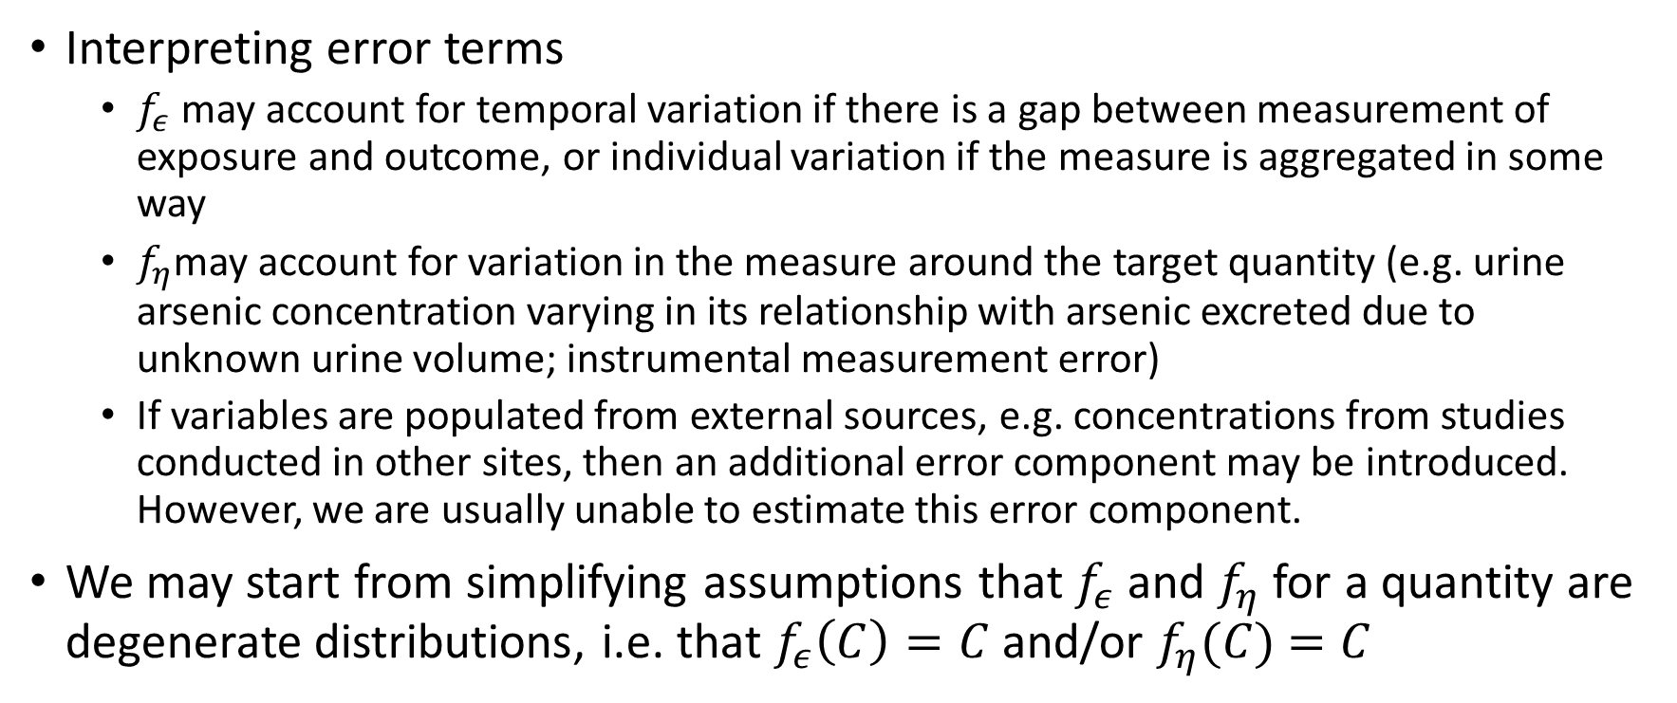
Monte Carlo Simulation framework
Interpreting error terms
$f_{ε}$ may account for temporal variation if there is a gap between measurement of exposure and outcome, or individual variation if the measure is aggregated in some way
$f_{η}$may account for variation in the measure around the target quantity (e.g. urine arsenic concentration varying in its relationship with arsenic excreted due to unknown urine volume; instrumental measurement error)
If variables are populated from external sources, e.g. concentrations from studies conducted in other sites, then an additional error component may be introduced. However, we are usually unable to estimate this error component.
We may start from simplifying assumptions that $f_{ε}$ and $f_{η}$for a quantity are degenerate distributions, i.e. that $f_{ε}\left(C\right)=C$ and/or $f_{η}(C)$ $=C$

Slide 5
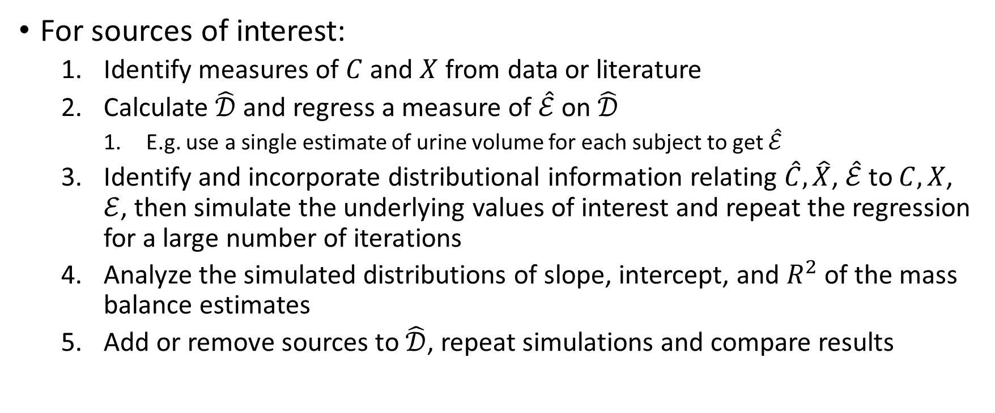
Proposed workflow
For sources of interest:
Identify measures of $C$ and $X$ from data or literature
Calculate $\hat{𝒟}$ and regress a measure of $\hat{ℰ}$ on $\hat{𝒟}$
E.g. use a single estimate of urine volume for each subject to get $\hat{ℰ}$
Identify and incorporate distributional information relating $\hat{C},\hat{X}$, $\hat{ℰ}$ to $C,X$, $ℰ$, then simulate the underlying values of interest and repeat the regression for a large number of iterations
Analyze the simulated distributions of slope, intercept, and $R^{2}$ of the mass balance estimates
Add or remove sources to $\hat{𝒟}$, repeat simulations and compare results

